Slide 1
Cypress Test case Structure.

Slide 2
Chapter 3: Cypress Test case Structure.
Visit web page.
Cypress Commands for Querry elements
Locate or Select elements.
Interact with Element
Assertion

Slide 3
Cypress Test case Structure.
A solid Test generally covers 4 phases:
1. Visit a web page.
2. Query for an element.
3. Interact with that element.
4. Assert about the content on the page.

Slide 4
Visit web page.
We can pass the URL to cy.visit() methods to visit web page.
Uniform Resource Locator (URL) is a reference to a web resource that specifies its location.
URL is made up of two parts:
1.Base URL:
2. Relative URL:

Slide 5
Cypress Commands for Querry elements.
Parent Command
cy.get(selector)
cy.contains(visible_text_on_elementt )
Chiled command
.find(childSelector)
.first(childSelector)
.last(childSelector)
.eq(childSelector)

Slide 6
Cypress Commands for Querry elements.
Parent command
get methods:- gets one or more elements based on the selector passed as aparameter
contains methods:- Another way to locate things is to look them up by their content,
Cypress uses to chain commands together.
Chiled command
.find methods:- always chains with other methods that return DOM elements.
.first():- This method selects the first element in the collection of elements matched by the preceding command.
.last():- This method selects the last element in the collection of elements matched by the preceding command
.eq(index):- This method selects the element at the specified index within the collection of elements matched by the preceding command. The index is zero-based, so .eq(0) selects the first element,

Slide 7
Locator or Selector elements.
The Locator or Selector helps to locate an element in the webpage.
Cypress supports:-
1. CSS selectors by default.
2. XPath selectors by help of additional plugin

Slide 8
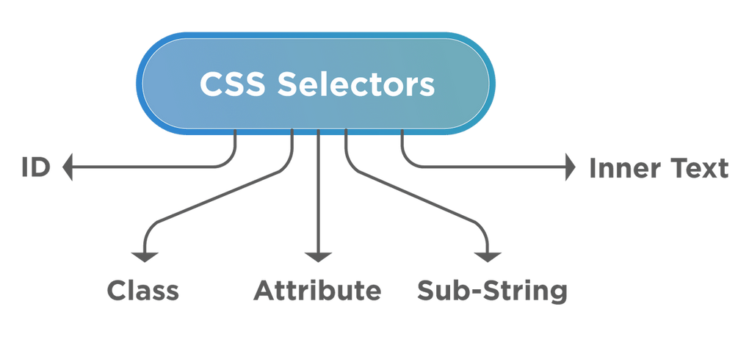
CSS selectors
We can write CSS selectors in multiple ways

Slide 9
XPath selectors
To install and configure cypress-xpath use the following step
Step 1: Install the cypress-xpath plugin using the below command:
npm install -D cypress-xpath
Step 2: Set Up XPath plugin
Navigate to cypress/support/index.js and add the below line
require('cypress-xpath')
Step 3: Use cy.xpath()

Slide 10
Test Runer Playground
The steps, how to use Cypress Selector Playground to grab locators?
1.First, open the Selector playground by clicking on the "Toggle" button.
2.Second, click on the "Selector" icon,
3.Third, click on the "Widgets" menu to grab its CSS selector.
4.Fourthly, click on the copy icon to copy the CSS selector.
5.Finally, you can use this CSS selector anywhere in your test.

Slide 11
Interact with that element.
Some commands in Cypress are for interacting with the DOM such as:
.click()
.dblclick()
.rightclick()
.type()
.clear()
.check()
.uncheck()
.select()
.trigger()
.selectFile()
We call these "action commands."

Slide 12
Assertions
Assertions are these validations in the test automation
Assertions classify into two segments based on the subject.
1. Implicit Assertions
2. Explicit Assertions

Slide 13
Implicit Assertions
When the assertion applies to the object provided by the parent chained command.
Implicit Assertions use commands such as:
.should()
.and()
Generally, we use Implicit assertions when we want to:
Assert multiple validations about the same subject.

Slide 14
Explicit Assertion
If an assertion is applicable to an object directly, it is known as the explicit assertion.
This category of assertions contains the commands such as
expect()
assert()
Generally, You will be using "Explicit assertions"
Perform some custom logic before making the assertions on the given subject.

Slide 15
Common Cypress Assertions
have.length
have.class
have.value
contain
be.visible
exist
be.checked
have.css

Slide 16
Positive assertions Vs Negative assertions
A positive assertion is an affirmative statement.
Example:
cy.url().should('include','project')
.should('contain','project')
.should('eq','http://127.0.0.1:5500/project/form.html')
The Negative assertions have the "not" chainer prefixed to the assertion.
A Negative assertions show what is not true.
Example
cy.url().should('include','project')
.should('not.contain','project')
.should('eq','http://127.0.0.1:5500/project/form.html')

Slide 17
https://www.tutorialspoint.com/cypress/index.htm
https://toolsqa.com/cypress-tutorial/
https://docs.cypress.io/examples/tutorials
https://mindmajix.com/cypress-tutorial

